Slide 1
At-risk behaviors
By: Julia Cuellar
DSC 530
Final Project

Slide 2

Statistical question
Morning
What shift do most at-risk behaviors occur and are employees with less than a year employment the most at-risk?
Sunrise
Day
Twilight
Night

Slide 3
Hypothesis
Out of the shifts (Morning, Sunrise, Day, Twilight, & Night), Sunrise will have the most at-risk behaviors and employees with less than a year of employment will be less at-risk than employees with more than a year of employment.

Slide 4
At-risk behaviors.csv
Variables:
Date
Week
Monday
Tuesday
Wednesday
Thursday
Friday
Saturday
Shift
Morning
Sunrise
Day
Twilight
Night
At-risk behavior
Push/pull
Overreach
Powerzone
Struck by/against
Load stand
Lifting/lowering
Hand-to-surface
Yard control
Egress
Slips/trips/falls
Cornerstone
Firm footing
3 p.o.c.
F.O.D.
Hydration
Employment
Under
Over
Job Function
Mail Handler
Freight Handler
Forklift Operator
Tug Driver

Slide 5
Arb: At-risk behaviors
Push/pull
Push equipment
Overreach
Don’t overextend, elbows bent
Powerzone
Stay within powerzone (armpits to mid-thigh)
Struck by/against
Be aware of surroundings
Load stand
Utilize load stand when out of powerzone while working in ULD (or can)
Lifting/lowering
Comply with 8 keys to lifting/lowering
Hand-to-surface
Apply the hand-to-surface method when working in ULD (or can)
Yard Control
Heed the yard control safety rules
Egress
Maintain egress to, thru, & away from work area
Slips/trips/falls
Plan for the unexpected
Cornerstone
Employ cornerstone method when working in ULD (or can)
Firm footing
Walk at a brisk pace
3 p.o.c.
Harness 3 points of contact
F.O.D.
Remove foreign object debris
Hydration
Stay hydrated

Slide 6
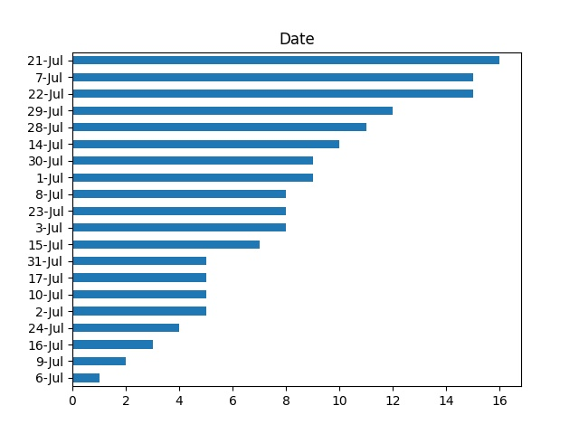
Bar Chart: Date
Considering that my data has only categorical variables (or str values), a bar chart is the best option to showcase the date column.
A possible outlier could be 7/6/20.

Slide 7
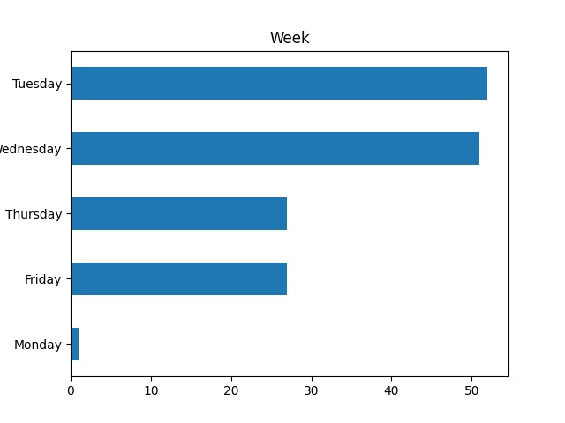
Bar Chart: Week
Considering that my data has only categorical variables (or str values), a bar chart (as close to a histogram as possible) is the best option to showcase the week column.
A possible outlier could be Monday.

Slide 8
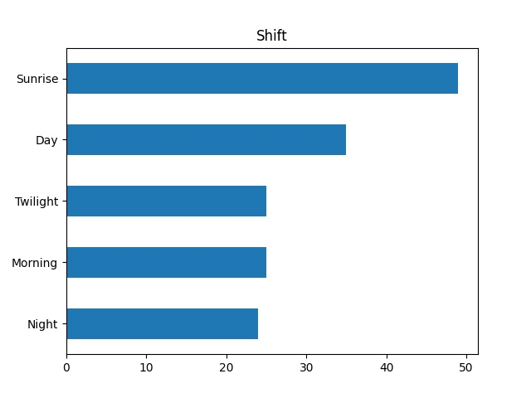
Bar Chart: Shift
Considering that my data has only categorical variables (or str values), a bar chart (as close to a histogram as possible) is the best option to showcase the shift column.
There are no outliers.

Slide 9
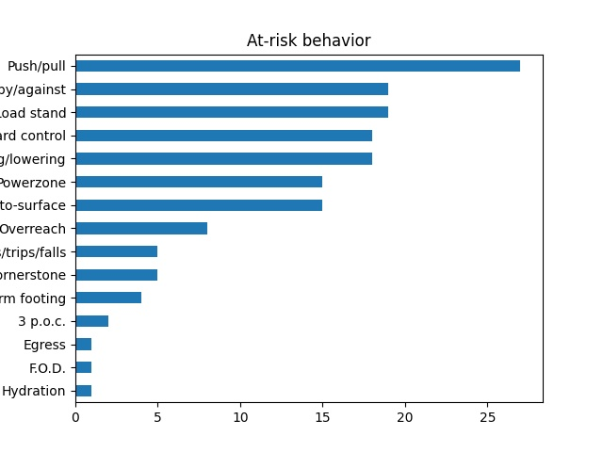
Bar Chart: At-risk behavior
Considering that my data has only categorical variables (or str values), a bar chart (as close to a histogram as possible) is the best option to showcase the at-risk behavior column.
Possible outliers could be Egress, F.O.D., or Hydration.

Slide 10
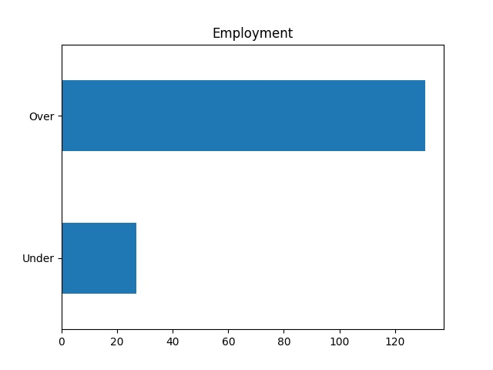
Bar Chart: Employment
Considering that my data has only categorical variables (or str values), a bar chart (as close to a histogram as possible) is the best option to showcase the employment column.
There are no outliers.

Slide 11
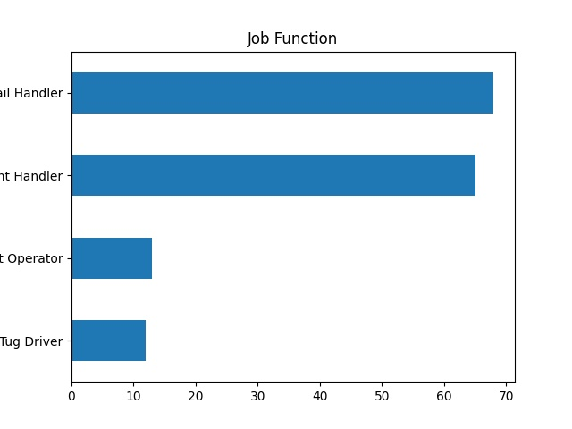
Bar Chart: Job Function
Considering that my data has only categorical variables (or str values), a bar chart (as close to a histogram as possible) is the best option to showcase the job function column.
There are no outliers.

Slide 12
Descriptive characteristics: Date
21-Jul 16
22-Jul 15
7-Jul 15
29-Jul 12
28-Jul 11
14-Jul 10
1-Jul 9
30-Jul 9
8-Jul 8
3-Jul 8
23-Jul 8
15-Jul 7
10-Jul 5
31-Jul 5
2-Jul 5
17-Jul 5
24-Jul 4
16-Jul 3
9-Jul 2
6-Jul 1
Name: Date, dtype: int64

Slide 13
Descriptive characteristics: Date
Once again, my data only has categorical variables (or str values), thus the mean, mode, spread, and tails can be calculated manually or observed from the plots.
Mean: (16+2(15)+12+11+10+2(9)+3(8)+7+4(5)+4+3+2+1)/(20) = 7.9 = 8 (if round up) or 7/3/20 or 7/8/20 or 7/23/20
Mode: 16 or 7/21/20
Spread: 15 or 7/7/20 or 7/22/20
Tails: Low tail = 1 or 7/6/20 & High tail = 16 or 7/21/20

Slide 14
Descriptive characteristics: Week
Tuesday 52
Wednesday 51
Friday 27
Thursday 27
Monday 1
Name: Week, dtype: int64

Slide 15
Descriptive characteristics: Week
Once again, my data only has categorical variables (or str values), thus the mean, mode, spread, and tails can be calculated manually or observed from the plots.
Mean: (52+51+2(27)+1)/5 = 31.6 or Thursday or Friday (if round down)
Mode: 52 or Tuesday
Spread: 51 or Wednesday
Tails: Low tail = 1 or Monday & High tail = 52 or Tuesday

Slide 16
Descriptive characteristics: Shift
Sunrise 49
Day 35
Morning 25
Twilight 25
Night 24
Name: Shift, dtype: int64

Slide 17
Descriptive characteristics: Shift
Once again, my data only has categorical variables (or str values), thus the mean, mode, spread, and tails can be calculated manually or observed from the plots.
Mean: (49+35+2(25)+24)/5 = 31.6 or Day (if round up)
Mode: 49 or Sunrise
Spread: 25 or Morning or Twilight
Tails: Low tail = 24 or Night & High tail = 49 or Sunrise

Slide 18
Descriptive characteristics: At-risk behavior
Push/pull 27
Struck by/against 19
Load stand 19
Yard control 18
Lifting/lowering 18
Powerzone 15
Hand-to-surface 15
Overreach 8
Slips/trips/falls 5
Cornerstone 5
Firm footing 4
3 p.o.c. 2
F.O.D. 1
Hydration 1
Egress 1
Name: At-risk behavior, dtype: int64

Slide 19
Descriptive characteristics: At-risk behavior
Once again, my data only has categorical variables (or str values), thus the mean, mode, spread, and tails can be calculated manually or observed from the plots.
Mean: (27+2(19)+2(18)+2(15)+8+2(5)+4+2+1(3))/15 = 10.53 or 8 (if round down) or Overreach
Mode: 27 or Push/pull
Spread: 26 or 27 (if round up) or Push/pull
Tails: Low tail = 1 or Egress or F.O.D. or Hydration & High tail = 27 or Push/pull

Slide 20
Descriptive characteristics: Employment
Over 131
Under 27
Name: Employment, dtype: int64

Slide 21
Descriptive characteristics: Employment
Once again, my data only has categorical variables (or str values), thus the mean, mode, spread, and tails can be calculated manually or observed from the plots.
Mean: (131+27)/2 = 79 or 27 (if round down) or 131 (if round up) or Under or Over
Mode: 131 or Over
Spread: 104 or 131 (if round up) or Over
Tails: Low tail = 27 or Under & High tail = 131 or Over

Slide 22
Descriptive characteristics: Job Function
Mail Handler 68
Freight Handler 65
Forklift Operator 13
Tug Driver 12
Name: Job Function, dtype: int64

Slide 23
Descriptive characteristics: Job Function
Once again, my data only has categorical variables (or str values), thus the mean, mode, spread, and tails can be calculated manually or observed from the plots.
Mean: (68+65+13+12)/4 = 39.5 or 65 (if round up) or Freight Handler
Mode: 68 or Mail Handler
Spread: 56 or 65 (if round up) or Freight Handler
Tails: Low tail = 12 or Tug Driver & High tail = 68 or Freight Handler

Slide 24
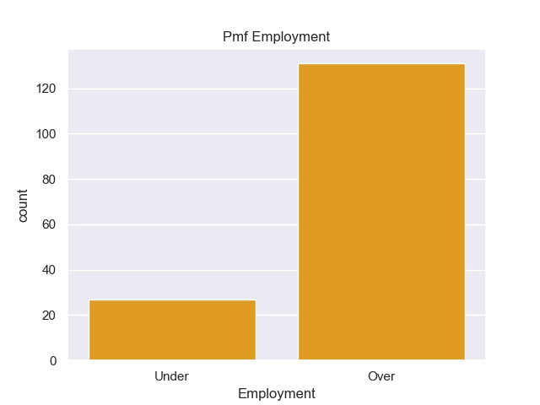
Pmf Employment
From the descriptive characteristics of the categorical variable ‘Employment’, the count for employees under a year of employment is 27 while the count for employees over a year of employment is 131.
Therefore, the Pmf can be manually calculated as:
Under = 27/158 or 0.17
Over = 131/158 or 0.83

Slide 25
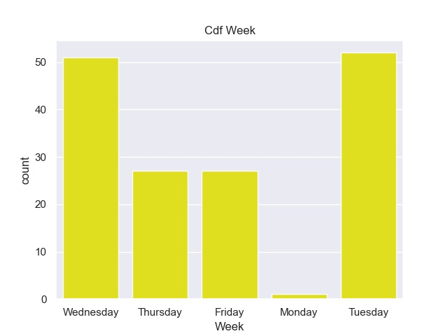
Cdf: Week
From the descriptive characteristics of the categorical variable ‘Week’, the count for Wednesday is 51, Thursday is 27, Friday is 27, Monday is 1, and Tuesday is 52.
If I were to add a Cdf, ‘Saturday’ to the categorical variable ‘Week’, the Cdf would equal 0 because:
7/4/20 was a holiday (no work), 3 Saturdays left
Only Morning & Sunrise shifts work on Saturday
Saturday is rare occurrences for observations of at-risk behaviors
Mostly employees over a year of employment work on Saturday

Slide 26
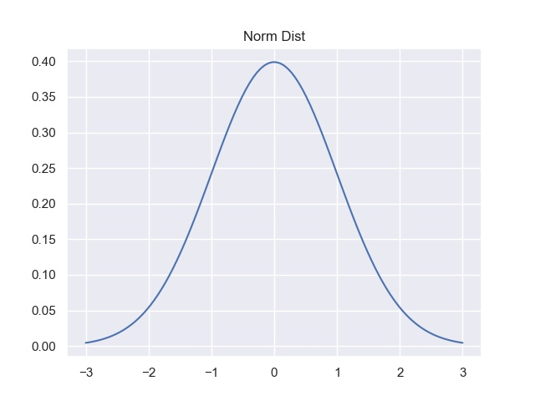
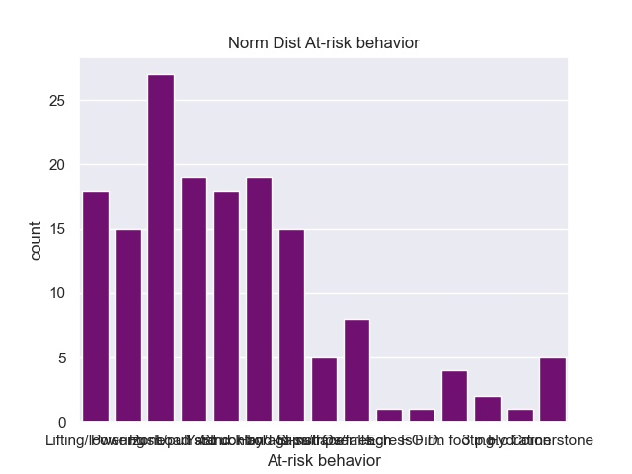
Normal Distribution: At-risk behaviors

Slide 27
Normal Distribution: At-risk behavior
The best distribution to display my categorical variable, ‘At-risk behavior’, is the normal distribution.
The normal distribution portrays many incidents in real world problems by the plot shape of a bell known as the bell-curve.
Once I displayed a simple normal distribution curve, I showcased a bar chart of my categorical variable, ‘At-risk behavior’, which formed in a somewhat bell-shaped curve.
Considering that if I plotted a bar chart for all my categorical variables, the normal distribution would still be utilized by the data clustering more towards the middle forming in a somewhat bell-shaped curve.

Slide 28
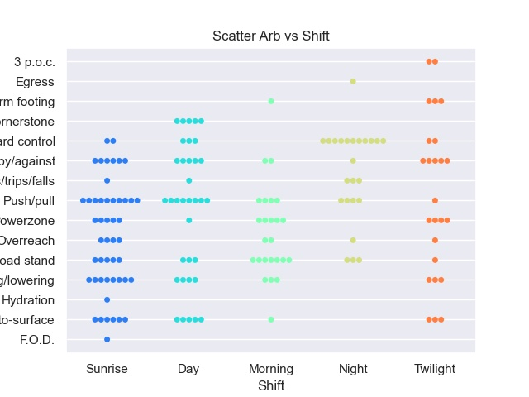
Swarm plot: At-risk behavior vs Shift
Considering that my data has only categorical variables (or str values), a swarm plot (as close to a scatterplot as possible because it looked cleaner) is the best option to present the at-risk behavior column versus the shift column.
Covariance and Pearson’s correlation will be calculated manually.

Slide 29
Swarm plot: At-risk behavior vs Shift
Mean of arb = 10.53
Mean of shift = 31.6
(27-10.53)+2(19-10.53)+2(18-10.53)+2(15-10.53)+(8-10.53)+2(5-10.53)+(4-10.53)+(2-10.53)+3(1-10.53) = 0.05
(49 – 31.6)+(35-31.6)+2(25-31.6)+(24-31.6) = 0
Covariance = 0
Pearson’s correlation = 0
The relationship between at-risk behavior versus shift is non-linear because Pearson’s correlation equals 0 and it is also indicated from the plot displayed.

Slide 30
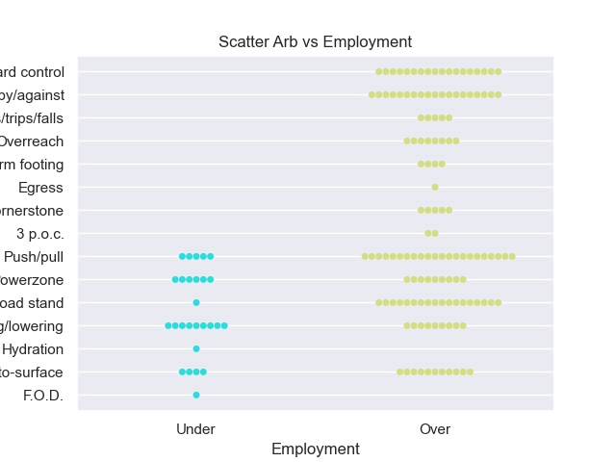
Swarm plot: At-risk behavior vs Employment
Considering that my data has only categorical variables (or str values), a swarm plot (as close to a scatterplot as possible because it looked cleaner) is the best option to present the at-risk behavior column versus the employment column.
Covariance and Pearson’s correlation will be calculated manually.

Slide 31
Swarm plot: At-risk behavior vs Employment
Mean of arb = 10.53
Mean of emp = 79
(27-10.53)+2(19-10.53)+2(18-10.53)+2(15-10.53)+(8-10.53)+2(5-10.53)+(4-10.53)+(2-10.53)+3(1-10.53) = 0.05
(131-79)+(27-79) = 0
Covariance = 0
Pearson’s correlation = 0
The relationship between at-risk behavior versus shift is non-linear because Pearson’s correlation equals 0 and it is also indicated from the plot displayed.

Slide 32
Hypothesis Testing
Considering that my statistical question is what shift do most at-risk behaviors occur and are employees with less than a year employment the most at-risk, I propose a hypothesis test upon the correlation since I have already handled the correlation between at-risk behavior versus the shift/employment.
The null hypothesis in this case is that there is no correlation between at-risk behaviors and shift/employment.
I will use Pearson’s correlation which indicates that at-risk behavior versus shift/employment is non-linear, therefore, the null hypothesis is accepted and thus, the relationship between at-risk behavior versus shift/employment is not statistically significant.

Slide 33
Regression: Y = a + bX + ε
Dependent variable = At-risk behavior
Independent (or Explanatory) variables = Shift & Employment
Regression will be calculated manually.
a_1 = (27+2(19)+2(18)+2(15)+8+2(5)+4+2+3(1))(49+35+2(25)+24)^2-(49+35+2(25)+24)(49+35+2(25)+24)(27+2(19)+2(18)+2(15)+8+2(5)+4+2+3(1))/5(49+35+2(25)+24)^2(49+35+2(25)+24)^2 = 0
b_1 = 5(27+2(19)+2(18)+2(15)+8+2(5)+4+2+3(1))(49+35+2(25)+24)-(49+35+2(25)+24)(27+2(19)+2(18)+2(15)+8+2(5)+4+2+3(1))/ 5(49+35+2(25)+24)^2-(49+35+2(25)+24)^2 = 0.8
a_2 = (27+2(19)+2(18)+2(15)+8+2(5)+4+2+3(1))(131+27)^2-(131+27)(131+27) (27+2(19)+2(18)+2(15)+8+2(5)+4+2+3(1))/2(131+27)^2-(131+27)^2 = 0
b_2 = 2((27+2(19)+2(18)+2(15)+8+2(5)+4+2+3(1))(131+27)- (27+2(19)+2(18)+2(15)+8+2(5)+4+2+3(1))(131+27)/2(131+27)^2-(131+27)^(2) = 1
Since a_1 (shift) and a_2 (employment) both equal 0, a regression analysis is unable to be performed, thus, once again concluding that at-risk behavior versus the shift/employment is a non-linear relationship with no statistical significance.

Slide 34
Conclusion
Even though my hypothesis was correct that most at-risk behaviors occur on the sunrise shift and employees under a year of employment as less likely to be more at-risk compared to employees over a year of employment, there is still bias and indeterminants. Basically, the reason why the sunrise shift had more at-risk behaviors compared to others because that is the shift that has the Safety Committee in it. Also, there is more employees observed who are over a year of employment compared to employees less than a year employment, thus, they are considered complacent towards their job function and therefore, tend to perform more at-risk behaviors.

